Slide 1
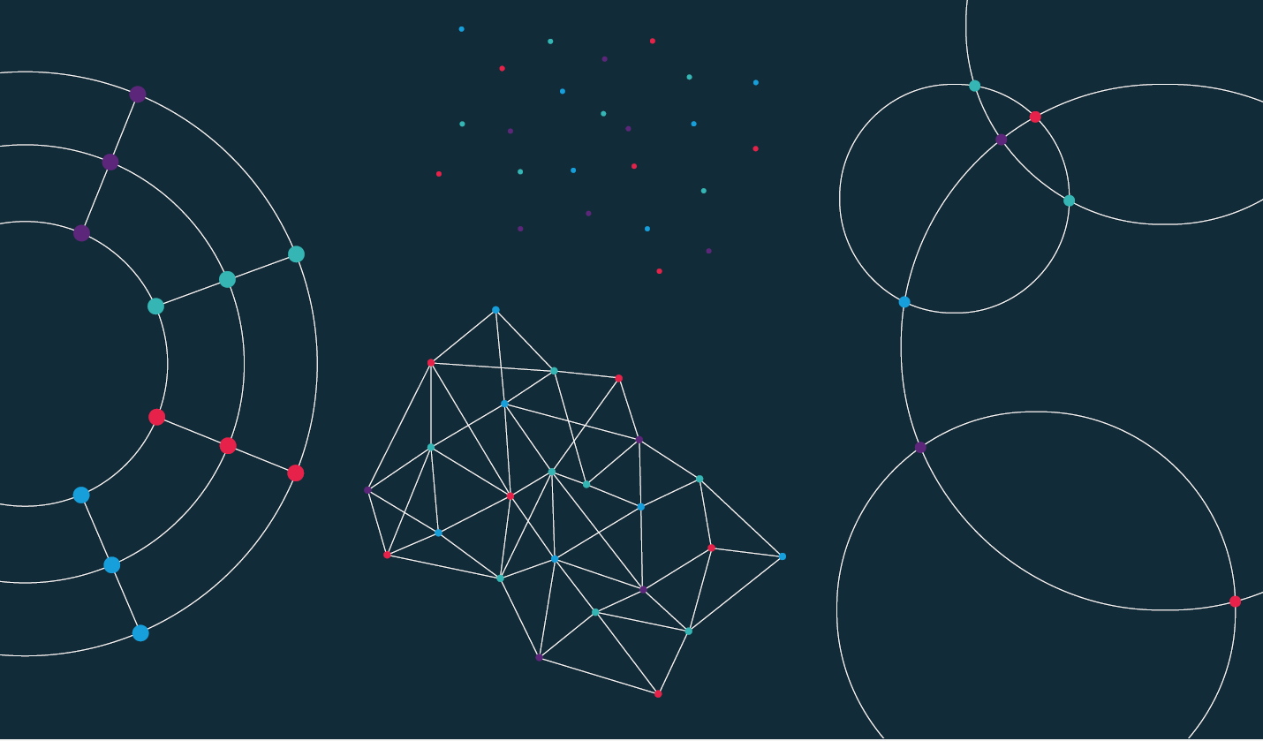

Slide 2
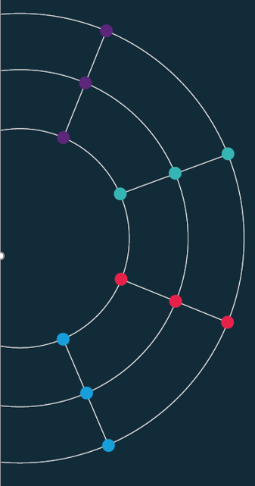
Session 5. Data scraping

Slide 3
Session 5. Data scraping
Scraping the HTML source

Slide 4
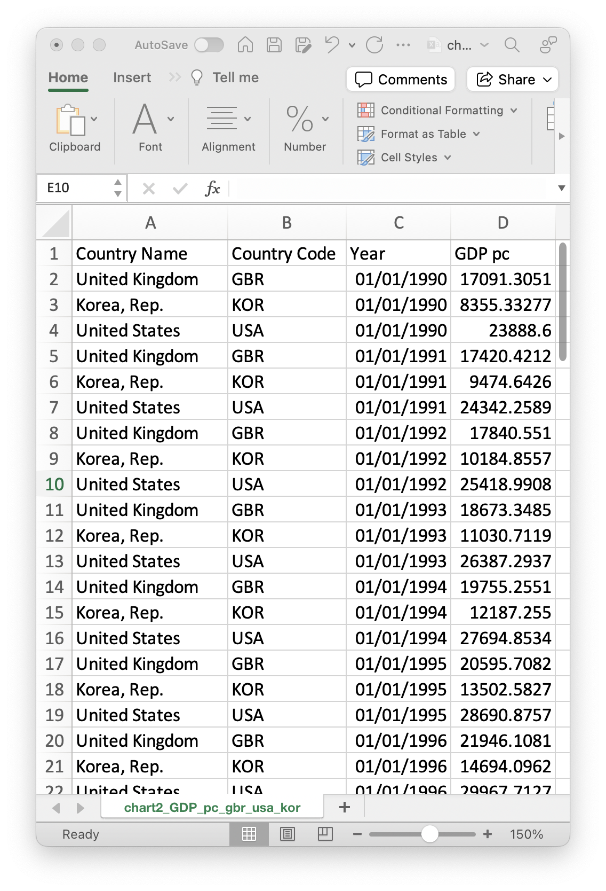
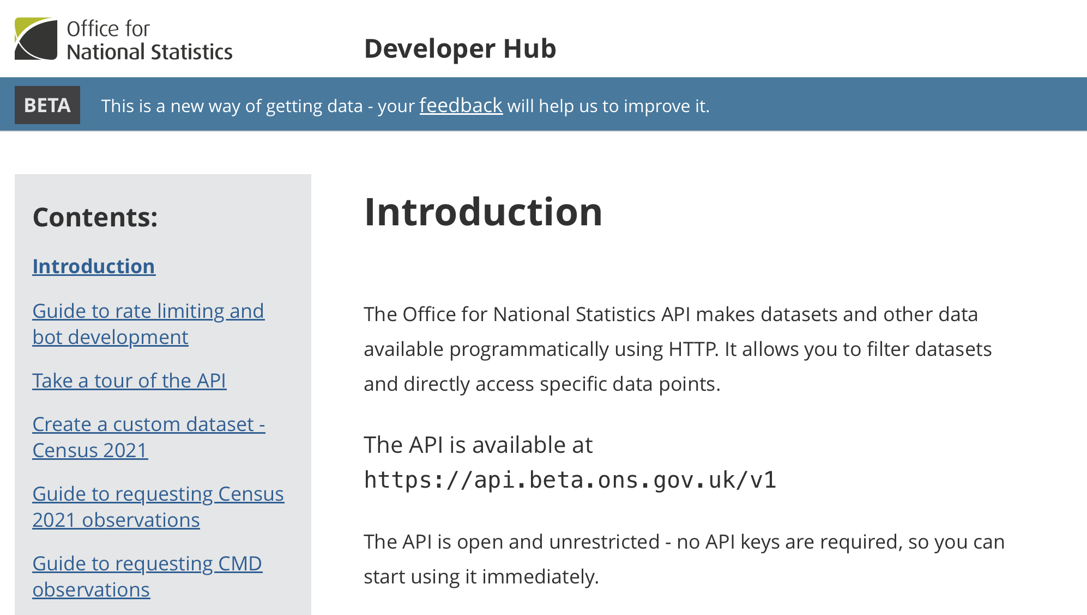
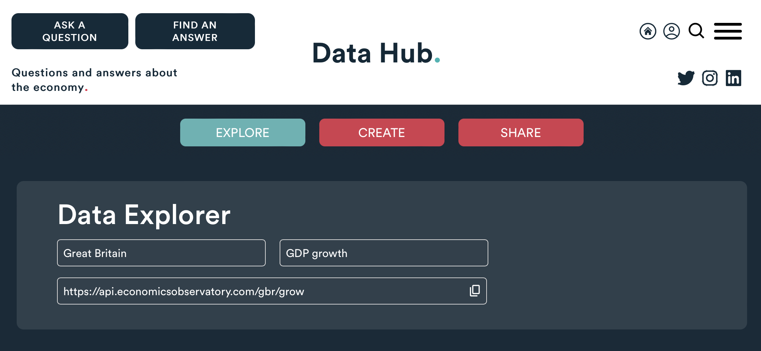
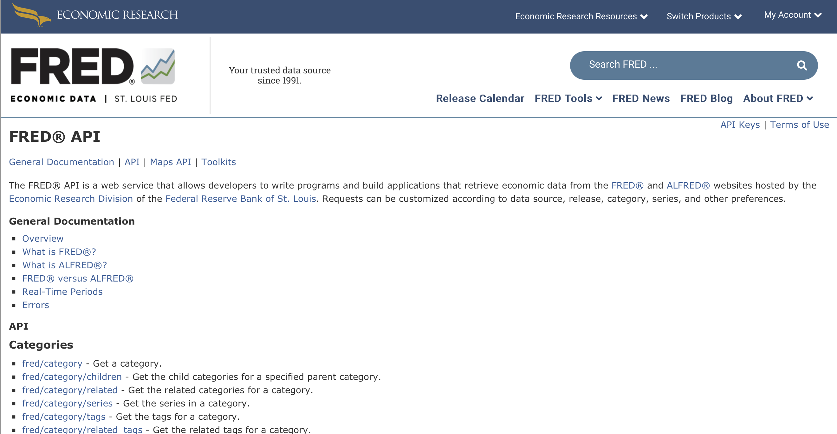
Data, so far...
Today we have used data from
Structured Files
(e.g. Excel, CSV, JSON)
APIs
(e.g. ONS, ECO, FRED)
But what do we do when the data we want isn’t available?

Slide 5
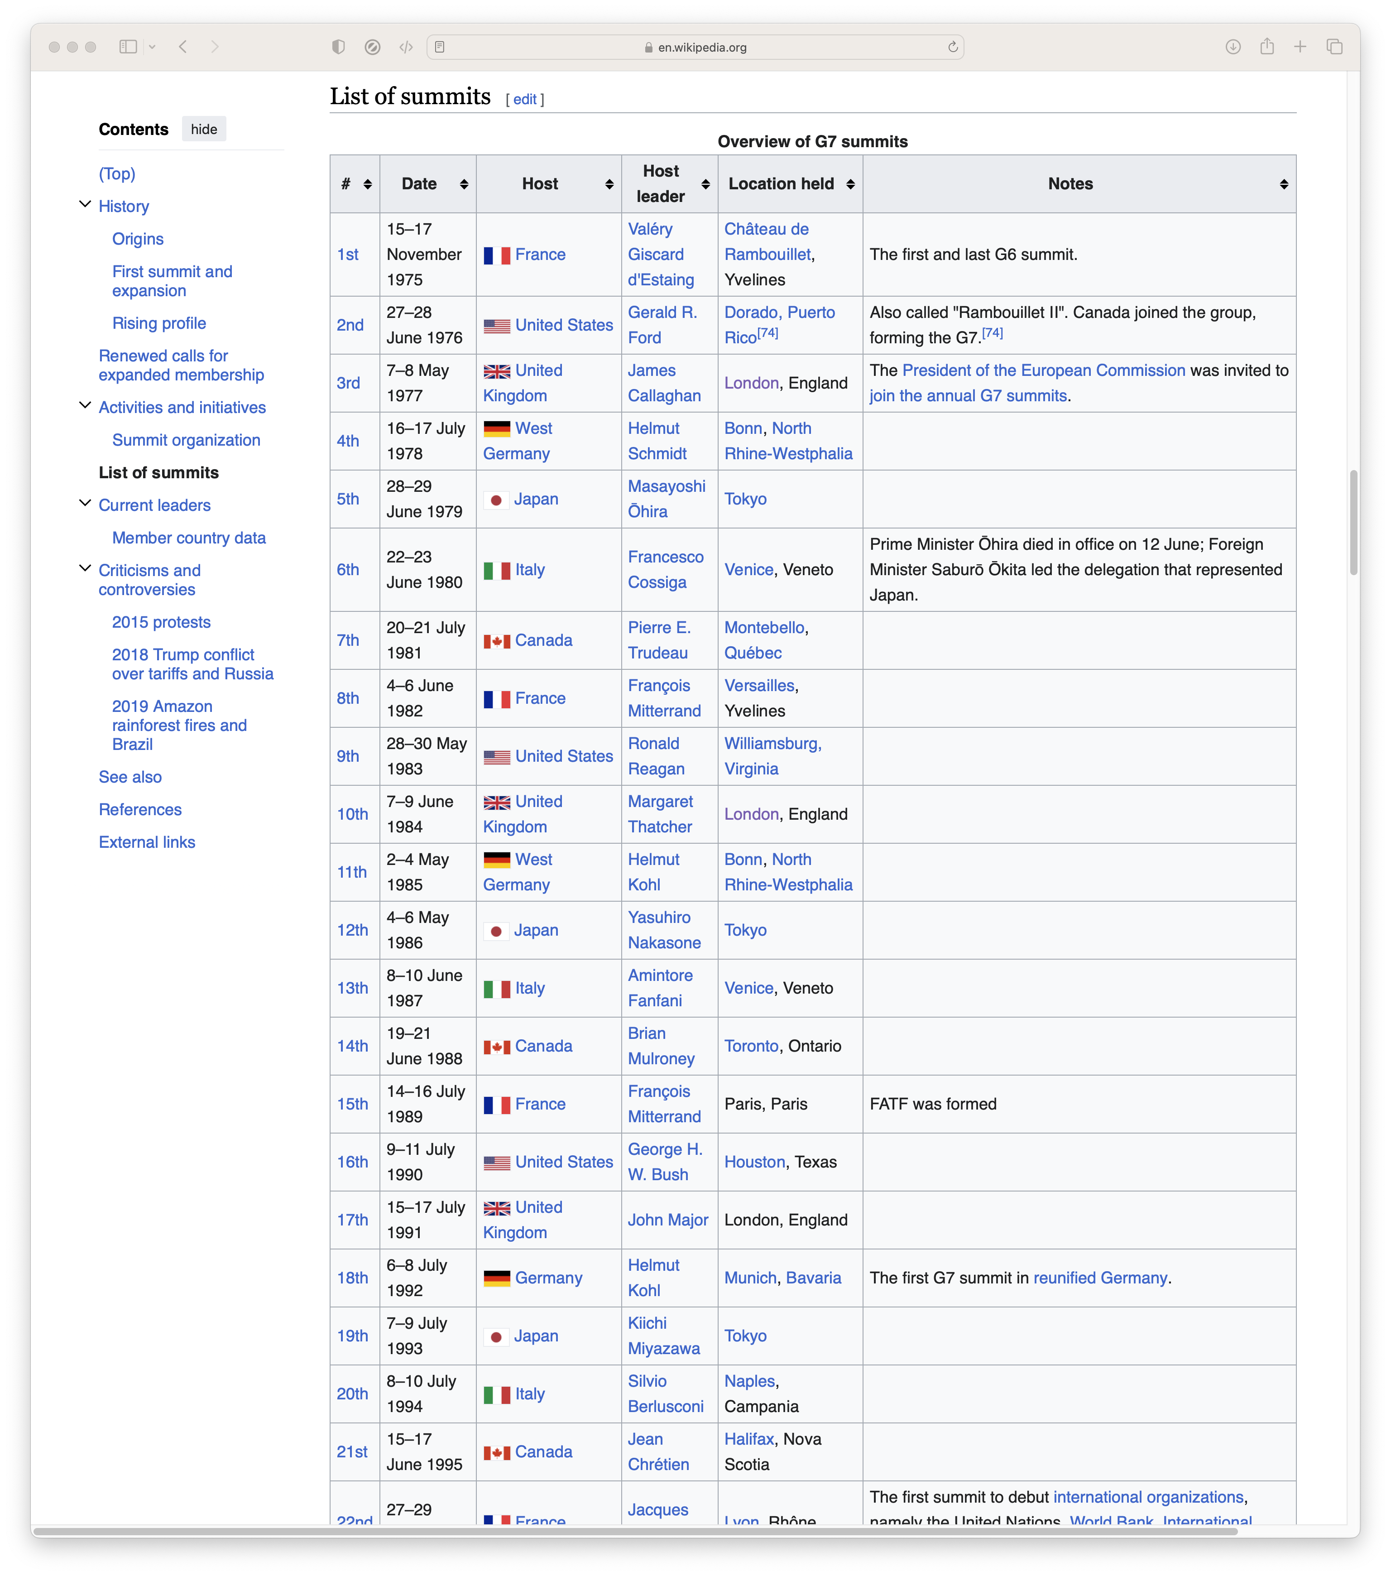
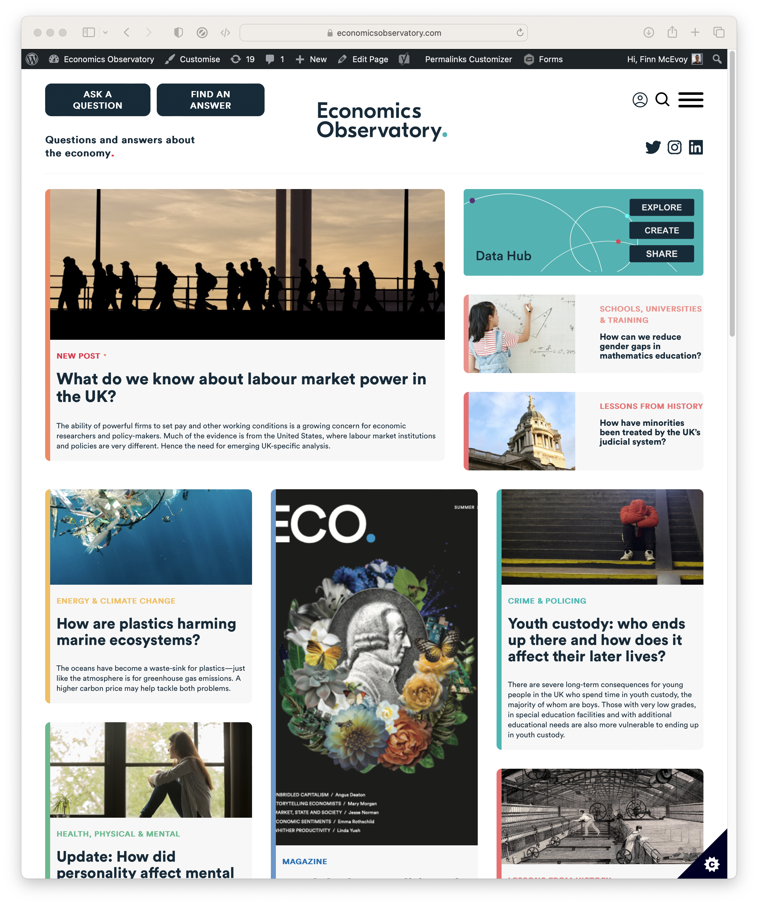
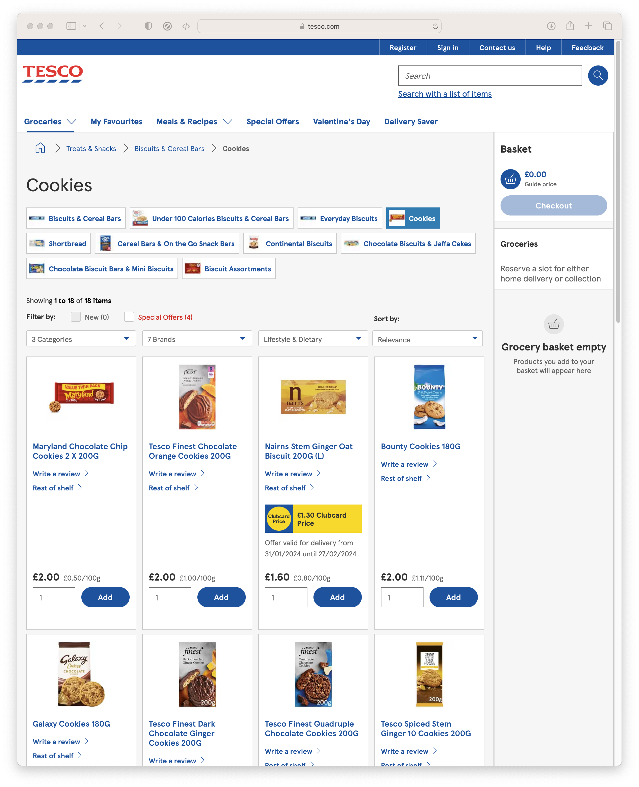
Data, so far...
What if we want
Data from Wikipedia
News and Media
Prices from Supermarkets

Slide 6
Scraping.
The automated extraction of data from websites
Scraping the HTML source. Easy. Automated.
Scraping static HTML pages.
A bit more difficult. Can be automated.
CAPTCHA. Impersonating a human user. Zombie browser.
Scraping HTML pages generated on-the-fly with JavaScript.
Hard. Only zombie browser works, and only in some cases.
hiQ labs vs. LinkedIn, 2019, US Court of Appeals for the Ninth Circuit, 17-16783
LinkedIn vs. hiQ labs, 2021, US Supreme Court, 19-1116

Slide 7
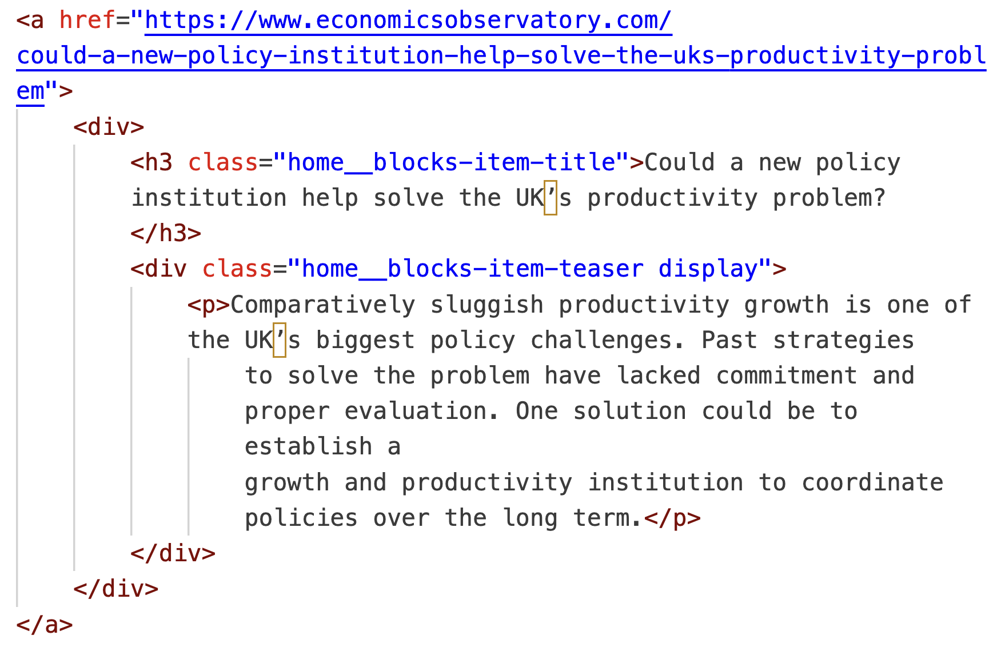
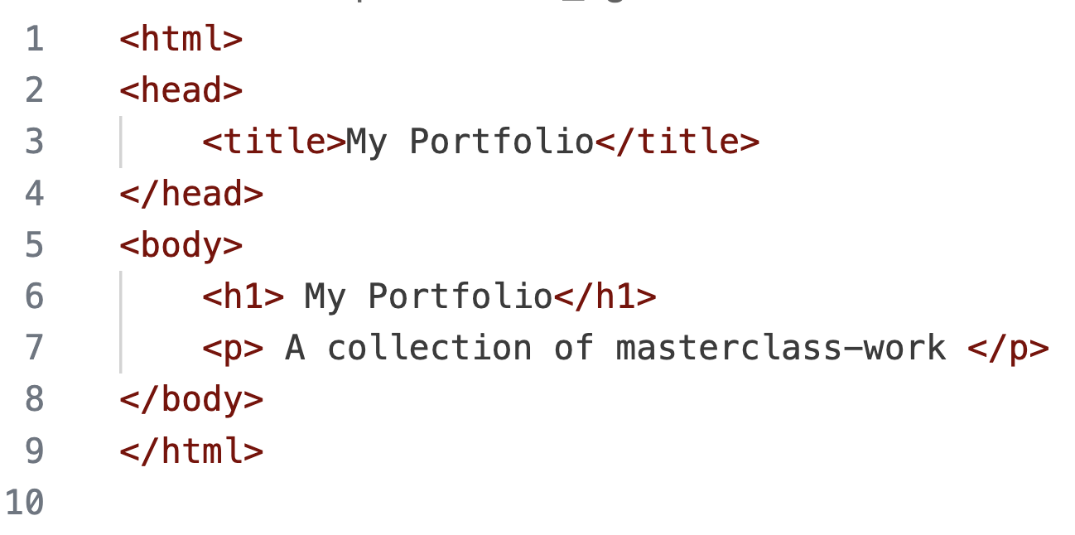
Parsing HTML.
We started today by writing HTML
We’ll end it by reading HTML

Slide 8
Parsing HTML.
(Almost) all the data displayed on websites is found in the HTML
We can extract data by searching the HTML
Everything is defined in the HTML, we just have to find it

Slide 9
Overview.
Determine how data is defined in HTML (inspect element)
Parse the HTML (Beautiful Soup)
Clean the data (Pandas)
Visualise (Vega-lite)

Slide 10
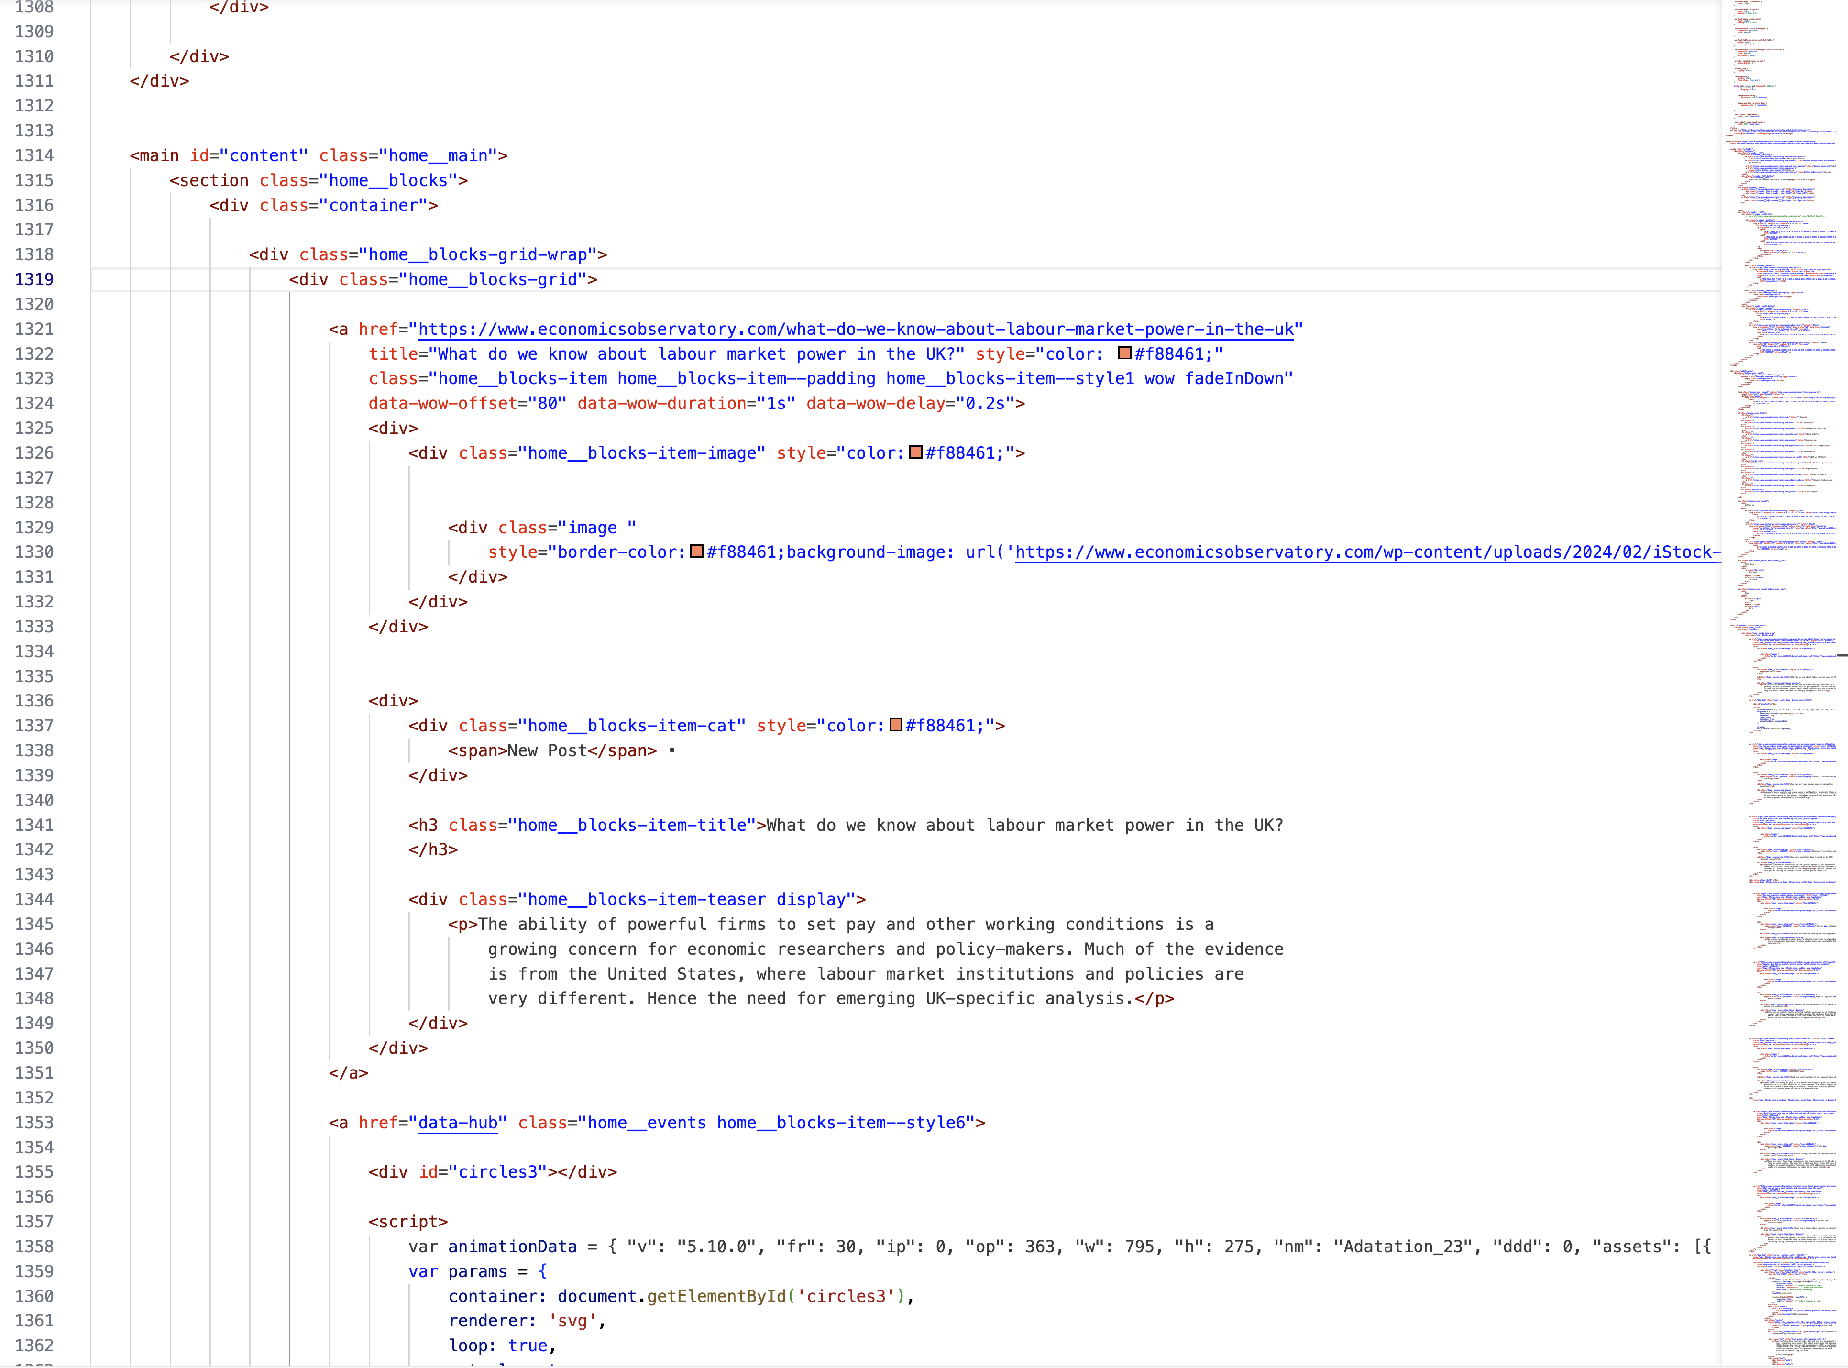
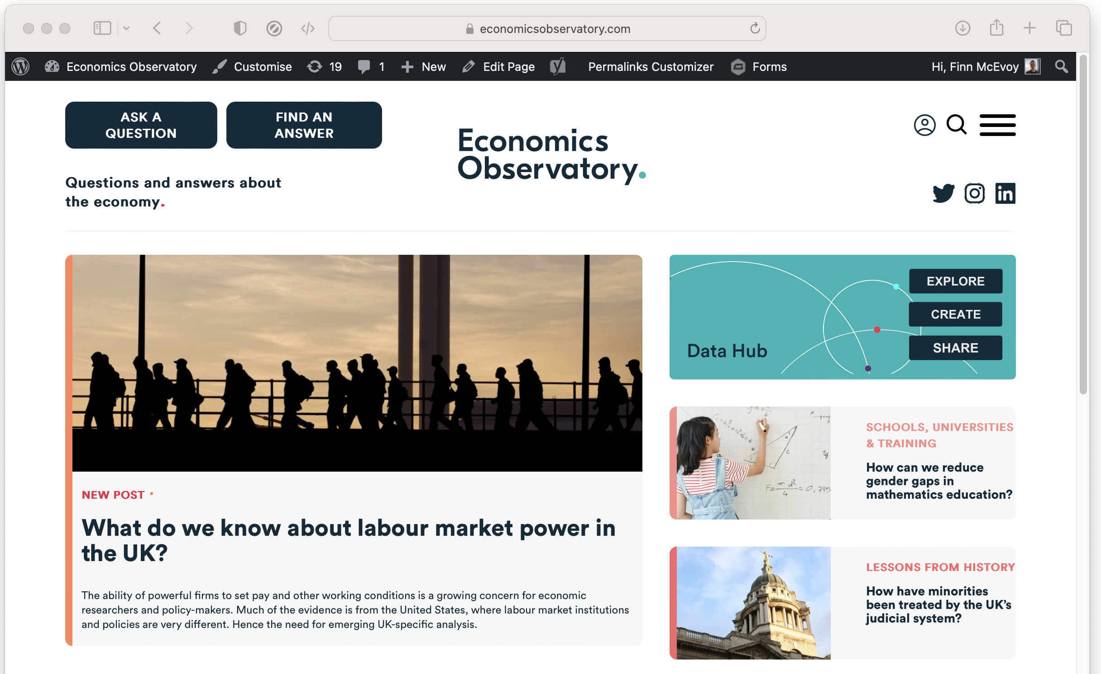
An Example.
For example, we can scrape ECO headlines and tag-lines by ‘parsing’ the HTML
Notes:
On this page, the HTML (2700 lines long!) defines the page we see

Slide 11
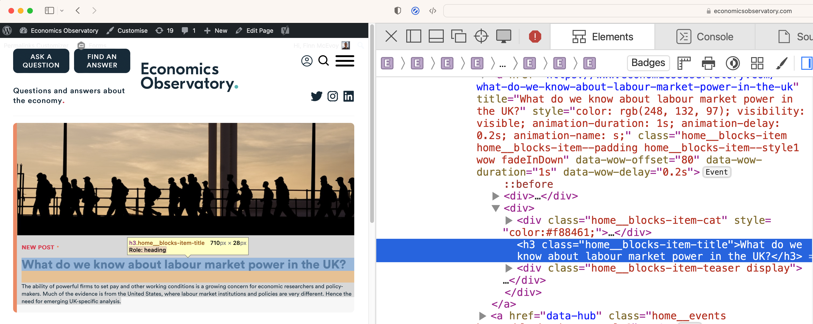
Using Inspect-Element.
We determine how the target data is defined using ‘inspect-element’
We see titles have a class “home_blocks-item-title”
Notes:
On this page, the HTML (2700 lines long!) defines the page we see

Slide 12
Parse the HTML
We’ll use use a Python module, BeautifulSoup, to interpret the HTML.
For example, we can look for every title by searching for:
class “home_blocks-item-title”
with
soup.find_all(class_="home__blocks-item-title")
Notes:
On this page, the HTML (2700 lines long!) defines the page we see

Slide 13
Code-along. A more advanced scraper
In this bonus practical session, we will use Google Colab to use scrape data from the Economics Observatory website using Python. Again, we can also embed a chart displaying the scraped data into your website, using VS Code and GitHub.
Work through the following guided notebook: “Session_5_Scraping.ipynb” (open in Google Colab)

Slide 14
Learn more.
In this session we have tried basic data scraping with BeautifulSoup
There’s still much more to learn
Choose your own projects (how can you make your job easier?)
Try bigger projects (scrape 100 pages, not just 1)
Try advanced tools (e.g. Selenium)
Notes:
On this page, the HTML (2700 lines long!) defines the page we see

Slide 15
Learn more, responsibly.
Rate-limiting: avoid making too many requests at once
Ethics: Ensure your scraping activities do not harm the website's operation
Data Privacy: Be mindful of personal data collection. Comply with relevant data protection laws (like GDPR).
Notes:
On this page, the HTML (2700 lines long!) defines the page we see

